Slide 1
Built In Functions

Slide 2
map()
map() is a built-in Python function that takes in two or more arguments: a function and one or more iterables, in the form:
map(function, iterable, ...)
Function : The function to execute for each item
Iterable : A sequence, collection or an iterator object. You can send as many iterables as you like, just make sure the function has one parameter for each iterable.

Slide 3
Examples :
Instead of defining function we can use lambda expression
map() can accept more than one iterable. The iterables should be the same length - in the event that they are not, map() will stop as soon as the shortest iterable is exhausted.

Slide 4
reduce()
The function reduce(function, sequence) continually applies the function to the sequence. It then returns a single value.
If seq = [ s1, s2, s3, ... , sn ], calling reduce(function, sequence) works like this.
Working :
At first step, first two elements of sequence are picked and the result is obtained.
Next step is to apply the same function to the previously attained result and the number just succeeding the second element and the result is again stored.
This process continues till no more elements are left in the container.
The final returned result is returned and printed on console.

Slide 5
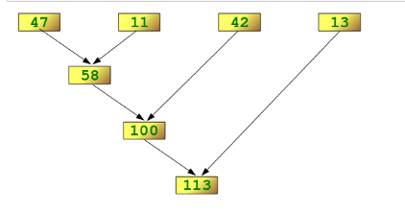
lst =[47,11,42,13] reduce(lambda x,y: x+y,lst)

Slide 6
filter()
The function filter(function,list) needs a function as its first argument
The function needs to return a Boolean value (either True or False)
This function will be applied to every element of the iterable
Only if the function returns True will the element of the iterable be included in the result.

Slide 7
zip()
The zip() function returns a zip object
An iterator of tuples where the first item in each passed iterator is paired together, and then the second item in each passed iterator are paired together etc.
If the passed iterators have different lengths, the iterator with the least items decides the length of the new iterator.

Slide 8
enumerate()
The enumerate() function takes a collection (e.g. a tuple) and returns it as an enumerate object.
The enumerate() function adds a counter as the key of the enumerate object.

Slide 9
all()
The all() function returns True if all items in an iterable are true, otherwise it returns False.
If the iterable object is empty, the all() function also returns True

Slide 10
any()
The any() function returns True if any item in an iterable are true, otherwise it returns False.
If the iterable object is empty, the any() function will return False.

Slide 11
complex()
The complex() function returns a complex number by specifying a real number and an imaginary number.

